Slide 1
ALY6080 XN Project
Presentation
Professor: Bryce Allen (Silicon Therapeutics)
Group Member: Yishuang Wang, Qiao Ma, Yingran Yang, Jiawen Xie, Wanqin Su, Yuhan Sun
Date: 04/01/2021

Slide 2
Content
01
Introduction
02
Data Selection
03
Exploratory Data Analysis
04
Target Background & Analysis
05
Reference

Slide 3
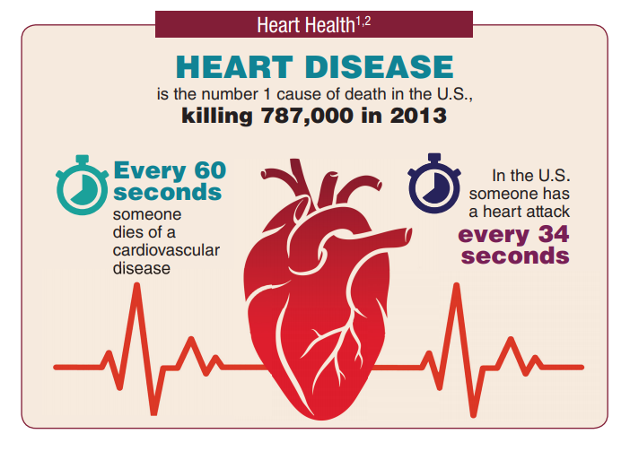
Introduction
Content
Content
Content
Content

Slide 4
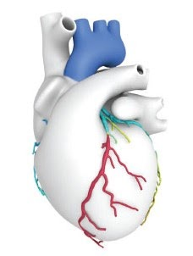
Introduction
Cardiovascular Disease (CVD) is a general term for conditions affecting the heart or blood vessels
It’s usually associated with a build-up of fatty deposits inside the arteries.
Heart disease costs the United States about $219 billion each year from 2014 to 2015.
Heart Disease Deaths Vary by Sex, Race, and Ethnicity
Heart Disease is still not curable.
Simple PowerPoint Presentation

Slide 5
Introduction
The goal is to identify a single protein target with high cardiovascular disease effectiveness and help the data-driven decision-making of the sponsor company through data visualization.
Provide the activity form of the top 5 targets, the Max Phase of each type of action, and the Max Phase of the top 5 target proteins of each type of action.
The dataset comes from ChEMBL.
Simple PowerPoint Presentation

Slide 6
Data Selection
ChEMBL - Open-access Drug Discovery Database
Data Source: 7 Medicinal Chemistry Journals (MedChemComm, Journal of Medicinal Chemistry, ACS Medicinal Chemistry Letters, European Journal of Medicinal Chemistry, Bioorganic & Medicinal Chemistry, Bioorganic & Medicinal Chemistry Letters, Journal of Natural Products)
Data Format: Transforming texts to labels and numbers (Extract from full text articles).
Goal: To capture medicinal chemistry data and knowledge across the pharmaceutical research and development process.
Scale: 15 million bioactivity measurements for 1.8 million distinct compounds.
⅔ data: activities of measuring against human, mouse or rat targets
Strengths: Reduce the cost, improve the development of drugs
Weakness: Missing data(Data is from journals, difficult to extract)
Pro-bono & no core data(Not much use for top companies)

Slide 7
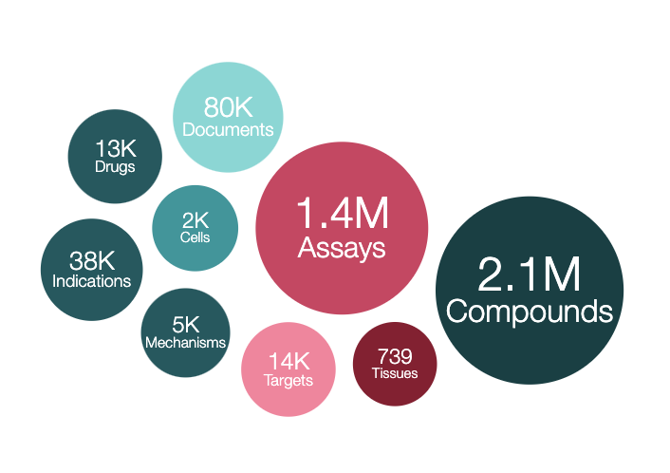
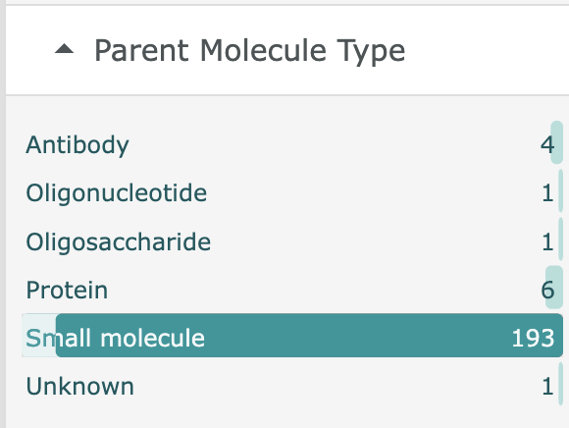
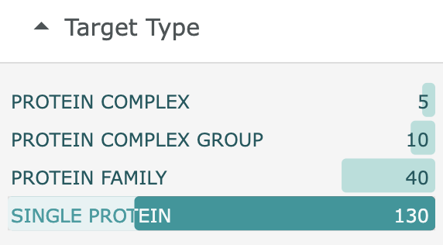
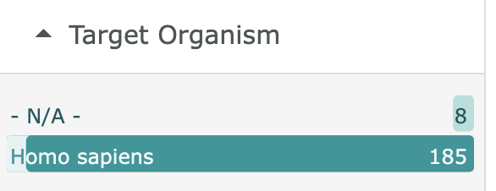
Data Selection
ChEMBL Database
https://www.ebi.ac.uk/chembl/
Browse Drug Indications for Cardiovascular Disease
Parent Molecule Type
Small molecule
Target Type
SINGLE PROTEIN
Target Organism
Homo sapiens

Slide 8
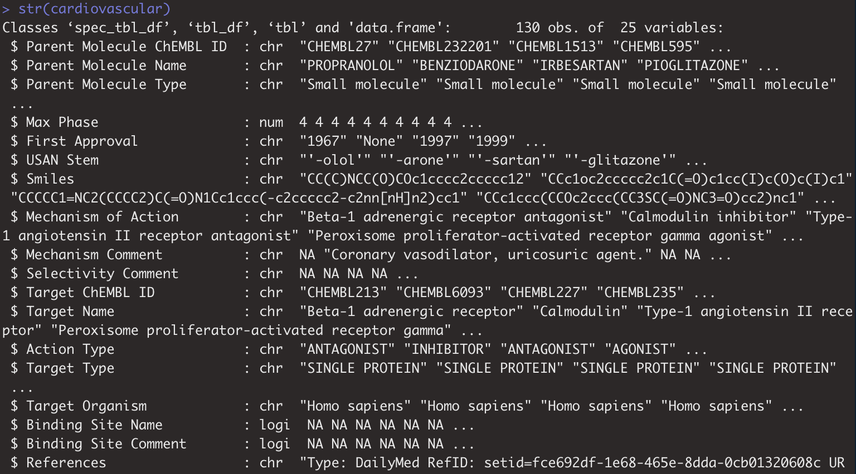
Exploratory Data Analysis (EDA)

Slide 9
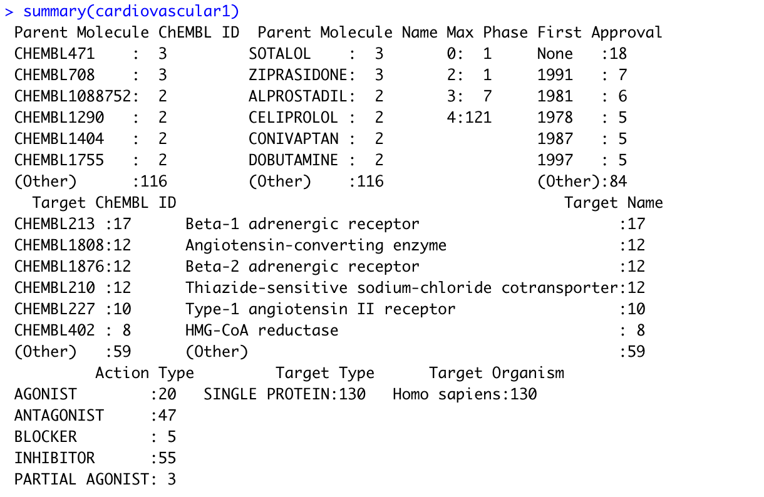
Exploratory Data Analysis (EDA)

Slide 10
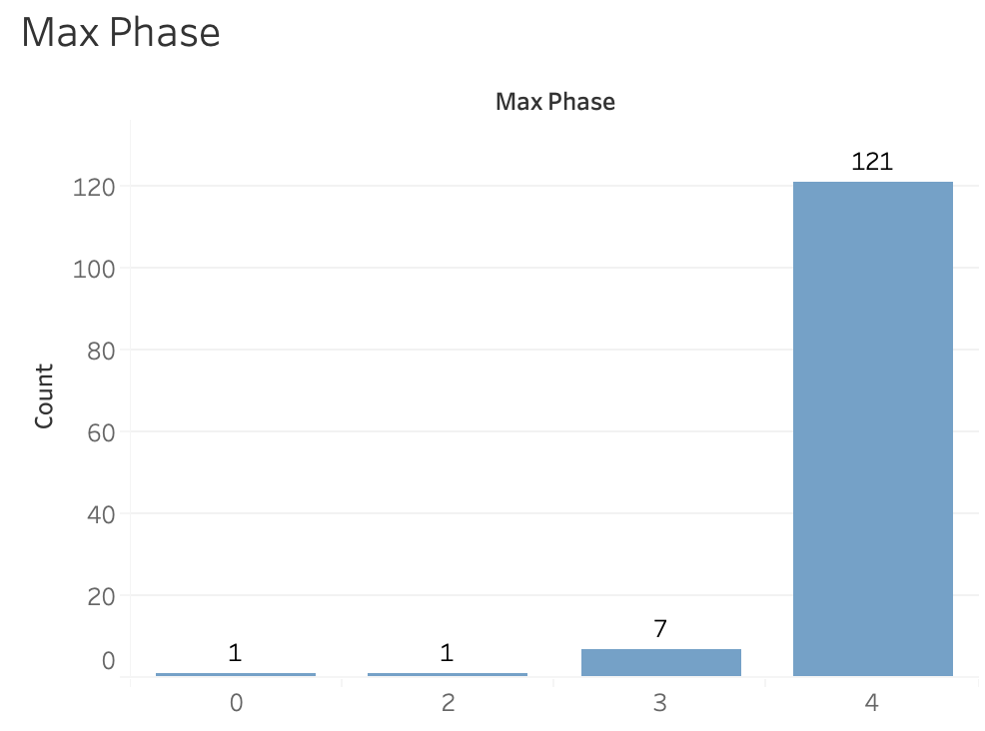
Exploratory Data Analysis (EDA)

Slide 11
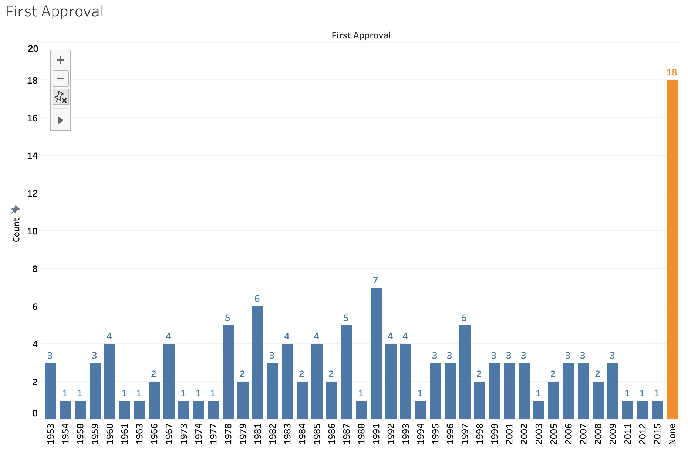
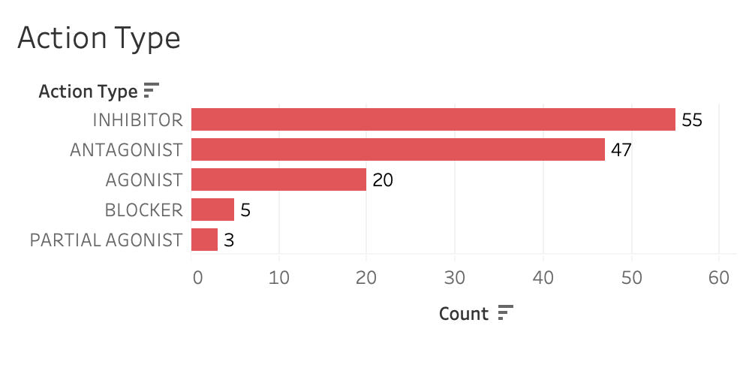
Exploratory Data Analysis (EDA)

Slide 12
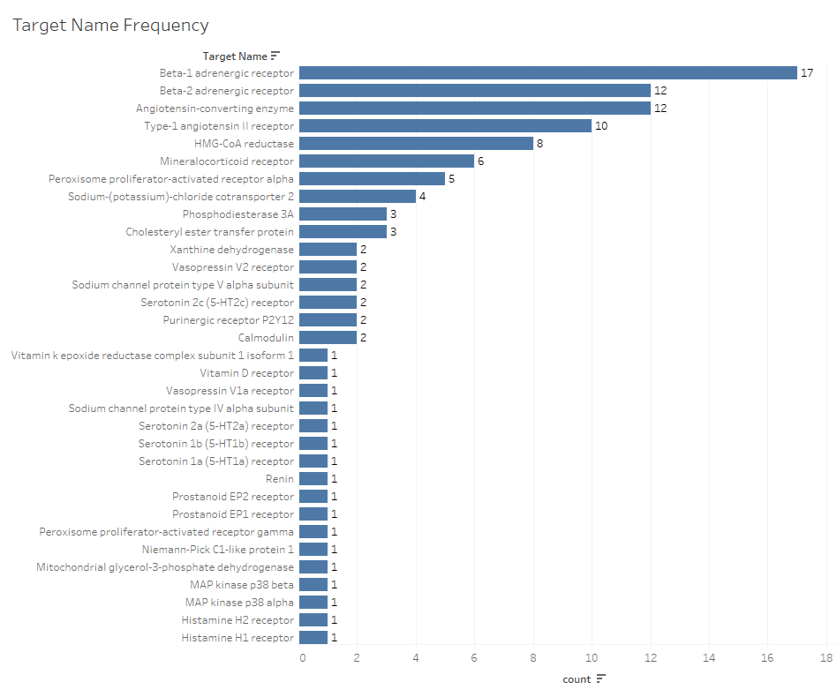
Exploratory Data Analysis (EDA)

Slide 13
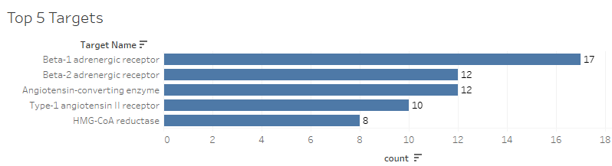
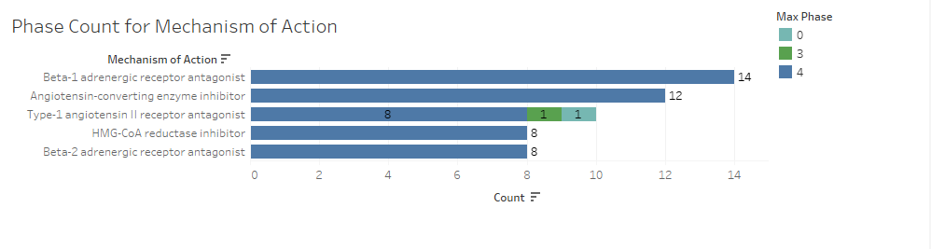
Top 5 Target Names

Slide 14
Top 5 Targets Background & Analysis
β1-adrenergic receptors antagonist
β2-adrenergic receptors antagonist
Angiotensin-converting enzyme inhibitors
Type-1 angiotensinⅡreceptor antagonist
HMG-CoA reductase inhibitor
70%
80%

Slide 15
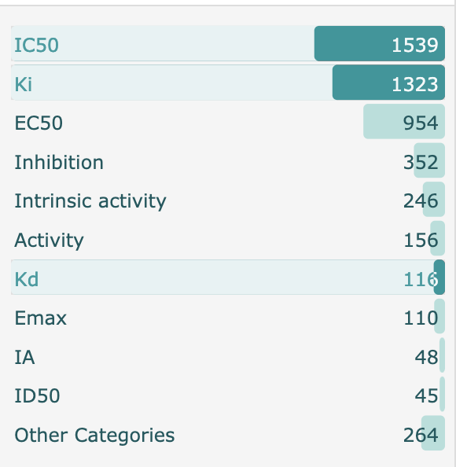
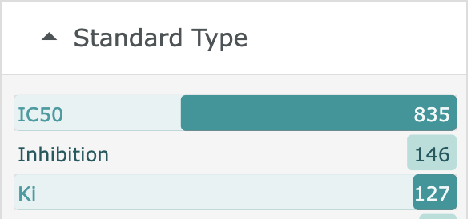
Targets Dataset Background
Inhibitor: IC50 & Ki
Antagonist: Kd & Ki & IC50

Slide 16
IC50/ Ki/ Kd Meaning
The IC50 is the concentration of an inhibitor where the response (or binding) is reduced by half.
Ki is reflective of the binding affinity and the IC50 is more reflective of the functional strength of the inhibitor for a drug. Since the Ki is calculated based on the IC50, the Ki is being reported more often by drug companies.
Kd is a measure of affinity. The equilibrium dissociation constant represents the concentration of radioligand occupying half of the maximum receptor population.

Slide 17
Assay type Meaning
Protein binding can involve plasma proteins, extracellular tissue proteins, or intracellular tissue proteins. Binding can enhance or detract from a drug's performance.
Functional assays can be defined as systematic in vivoexperiments that are designed to determine the involvement of each protein in a particular cellular pathway or biological process.
ADME assays are conducted to make decisions regarding drug candidate selection and movement into late-stage preclinical and clinical programs.

Slide 18
pChEMBL value
Negative log of selected concentration-response activity values (IC50/EC50/XC50/AC50/Ki/Kd/Potency).
It allows a number of roughly comparable measures of half-maximal response concentration/potency/affinity to be compared on a negative logarithmic scale.

Slide 19
β1-adrenergic receptors antagonist
β-adrenergic receptors are members of the G-protein-coupled receptor (GPCR), and their signal transduction plays a key role in the regulation of the cardiovascular system.
To normalize cardiac β1-AR levels can improve cardiac positive inotropic reserve and sympathetic innervation in an animal model of ischemic heart failure.
The most important receptor in the heart is the β-1 adrenergic receptor. When activated by β1 receptor agonists such as NE or EPI, heart rate increases, conduction velocity increases, contractility increases, and muscle cell relaxation rate is increased.
Causes
Heart
Heart failure
Cardiovascular Diseases
Lack of Energy
Common Clinical Event
β1-adrenergic receptors
Energy
X
Treatment
Drug Molecules
Heart
Heart failure
Activate
Myocardium
Aging

Slide 20
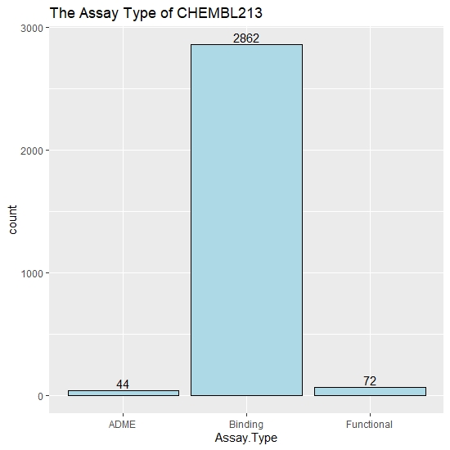
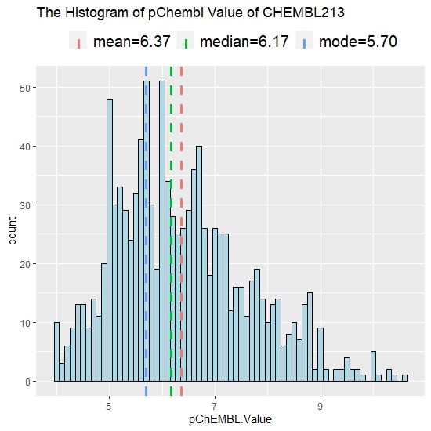
β1-adrenergic receptors antagonist

Slide 21
β2-adrenergic receptors antagonist
Beta-2 Adrenergic Receptor, also known as ADRB2, is a type of G Protein-Coupled Receptor.
Distributed on smooth muscles, and cause smooth muscle relaxation
Promote myocardial contraction and movement; Increase cardiac output; Dilate hepatic artery
Beta-2 Adrenergic Receptor Antagonists are the compounds used to block the activation.
This antagonist can be used to treat heart failure and hypertension, such as the drug Carvedilol.

Slide 22
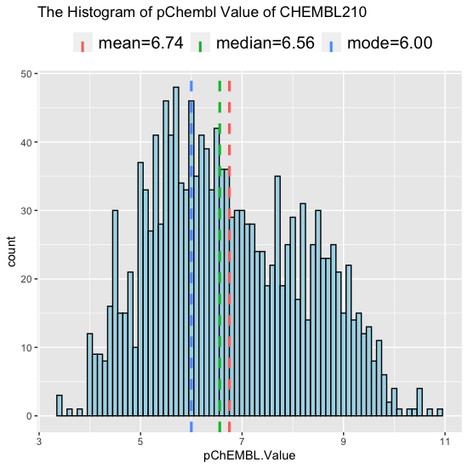
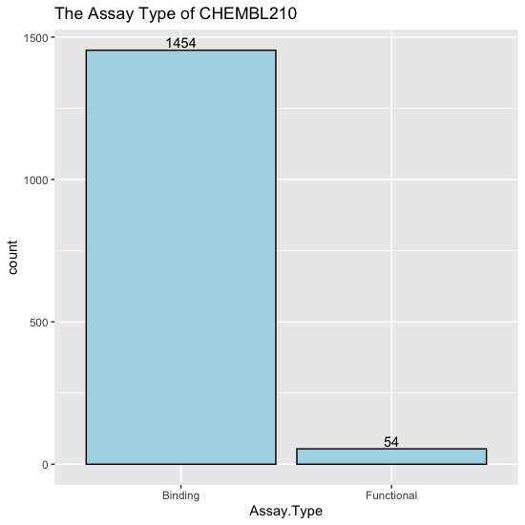
β2-adrenergic receptors antagonist

Slide 23
Angiotensin-converting enzyme inhibitors
Angiotensin converting enzyme inhibitors (ACE inhibitors) are medications that slow (inhibit) the activity of the enzyme ACE.
ACE inhibitors will enlarge blood vessels makes it easier for the heart to pump blood and can improve the function of a failing heart.
Angiotensin is one of the most powerful blood vessel narrower in the body.
Functions: Controlling high blood pressure; Preventing strokes; Treating heart failure
Side effects: Cough, Low blood pressure, Dizziness, Headache, Chest Pain

Slide 24
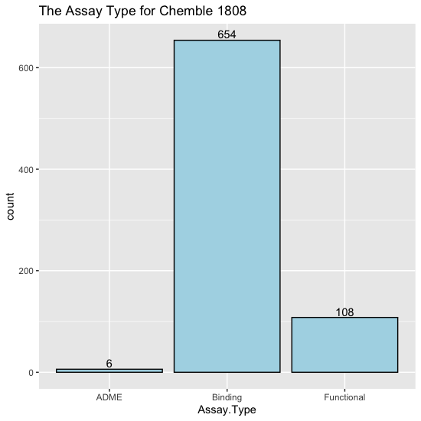
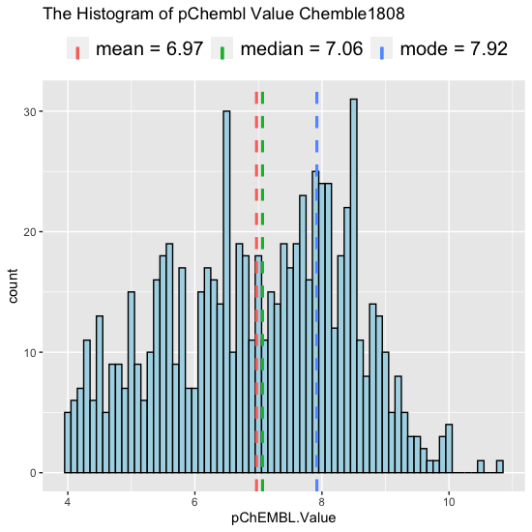
Angiotensin-converting enzyme inhibitors (ACE)

Slide 25
Type-1 angiotensin Ⅱ receptor antagonist
Angiotensin II receptor type 1 is the best characterized angiotensin receptor.
It has vasopressor effects and regulates aldosterone secretion.
It is an important effector controlling blood pressure and volume in the cardiovascular system.
Angiotensin II receptor antagonists are drugs indicated for hypertension, diabetic nephropathy and congestive heart failure.
AT1 receptor antagonists dose-dependently block the pressor response to exogenous angiotensin II.

Slide 26
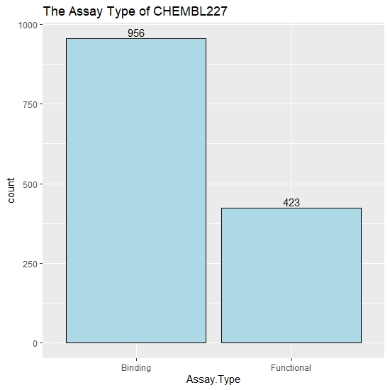
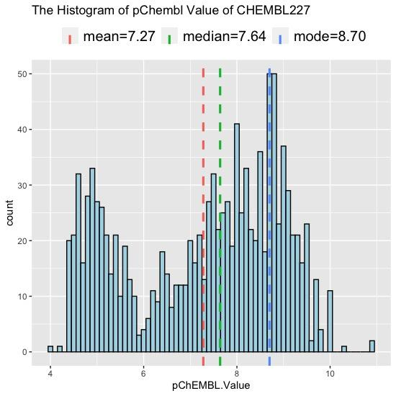
Type-1 angiotensin Ⅱ receptor antagonist

Slide 27
HMG-CoA reductase inhibitor
HMG-CoA reductase inhibitors (statins) are lipid-lowering medications used in the primary and secondary prevention of coronary heart disease.
Statins (HMG-CoA reductase inhibitor) can help prevent coronary artery disease and lower your risk of heart attack and stroke.
Mechanism of Action: Statins bind to the active site of the enzyme and induce a conformational change in its structure, thus reducing its activity.
Side-effect: Myalgia, Hepatic dysfunction, Renal dysfunction, Diabetes mellitus.

Slide 28
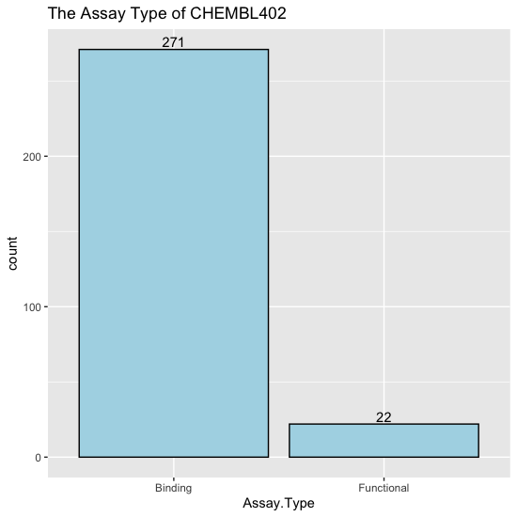
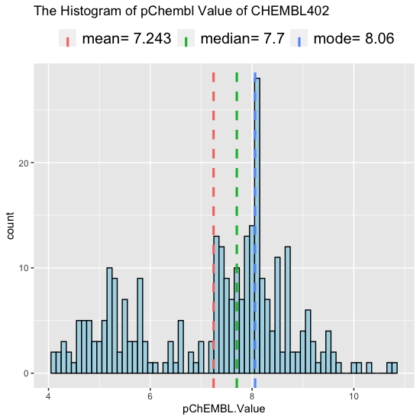
HMG-CoA reductase inhibitor

Slide 29
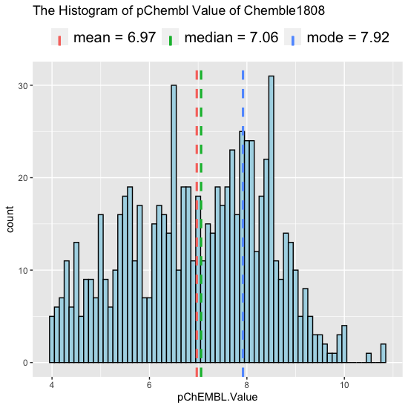
Target Comparison
ChEMBL227 has the highest mean
ChEMBL 213 (Size=1071) | β1-adrenergic receptor
ChEMBL 210 (Size=1508) | β2-adrenergic receptor
ChEMBL 1808 (Size=768) | Angiotensin-converting enzyme inhibitor
ChEMBL 227 (Size=1142) | Type-1 angiotensin Ⅱ receptor
ChEMBL 402 (Size=293) | HMG-CoA reductase inhibitor

Slide 30
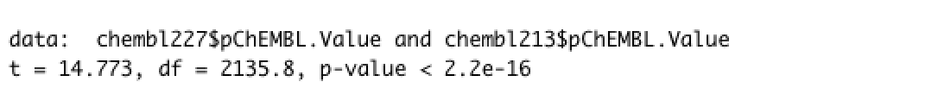
Hypothesis Test
Mu1: ChEMBL227; Mu2: ChEMBL213 H0: Mu1-Mu2=0; Ha: Mu1-Mu2>0
p-value < 2.2e-16, which means that p-value is less than 0.05, reject H0.
ChEMBL227 is better than ChEMBL213.
Mu1: ChEMBL227; Mu2: ChEMBL210 H0: Mu1-Mu2=0; Ha: Mu1-Mu2>0
p-value < 2.2e-16, which means that p-value is less than 0.05, reject H0.
ChEMBL227 is better than ChEMBL210.
Mu1: ChEMBL227; Mu2: ChEMBL1808 H0: Mu1-Mu2=0; Ha: Mu1-Mu2>0
p-value =7.033e-06, which means that p-value is less than 0.05, reject H0.
ChEMBL227 is better than ChEMBL1808.
Mu1: ChEMBL227; Mu2: ChEMBL402 H0: Mu1-Mu2=0; Ha: Mu1-Mu2>0
p-value=0.3587, which means that p-value is greater than 0.05, do not reject H0;
ChEMBL227(Type-1 angiotensin Ⅱ receptor antagonist)and ChEMBL402(HMG-CoA reductase inhibitor) are the best targets.

Slide 31
Reference
Ko, B., & Hoover, R. (2009, September). Molecular physiology of the thiazide-sensitive sodium-chloride cotransporter. Retrieved from https://www.ncbi.nlm.nih.gov/pmc/articles/PMC2947818/#:~:text=The%20thiazide%2Dsensitive%20so dium%2Dchloride,in%20the%20kidney%20%5B1%5D.
Adrenergic and cholinergic receptors in the heart. (2014). Retrieved from https://www.cvphysiology.com/Blood%20Pressure/BP010
Beckerman, J. (2019). Treating heart failure with ace inhibitors. Retrieved from https://www.webmd.com/heart- disease/heart-failure/heart- failure-ace-inhibitors#1
Burnier, M., Michel Burnier From the Division of Hypertension and Vascular Medicine, & Burnier, C. (2001). Angiotensin ii type 1 receptor blockers. Retrieved from https://www.ahajournals.org/doi/full/10.1161/01.CIR.103.6.904
Staff, H. (2020). Statins: Should i take them to prevent a heart attack or stroke? Retrieved from https://www.uofmhealth.org/health- library/aa44406
What is an inhibitory constant (ki) and how does it relate to understanding drug interactions? (2015). Retrieved from https://www.ebmconsult.com/articles/inhibitory-constant-ki-drug- interactions#:~:text=The%20inhibitory%20constant%20(Ki)%20and%20the%20IC50%20of%20a%20drug,of%20that%20enz yme%20by%20half.
Protein binding. (2018). Retrieved from https://www.sciencedirect.com/topics/pharmacology-toxicology-and-pharmaceutical-science/protein- binding
Cardiovascular Disease. NHS. Retrieved from https://www.nhs.uk/conditions/cardiovascular-disease/
ChEMBL Database. Retrieved from https://www.ebi.ac.uk/chembl/

Slide 32
THANK YOU

